Slide 1
Big Data Summary
5/9/2014
Map Reduce: Simplified Data Processing on Large Clusters¹
vs
A Comparison of Approaches to Large-Scale Data Analysis²
By Cassandra Graves
² Andrew Pavlo, Erik Paulson, Alexander Rasin, Daniel J. Abadi, David J. DeWitt, Samuel Madden, and Michael Stonebraker. 2009. A comparison of approaches to large-scale data analysis. In Proceedings of the 2009 ACM SIGMOD International Conference on Management of data (SIGMOD '09),
Carsten Binnig and Benoit Dageville (Eds.). ACM, New York, NY, USA, 165-178. DOI=10.1145/1559845.1559865 http://doi.acm.org/10.1145/1559845.1559865
¹Jeffrey Dean and Sanjay Ghemawat. 2008.
MapReduce: Simplified Data Processing on Large Clusters.
Commun. ACM 51, 1 (January 2008), 107-113.
DOI=10.1145/1327452.1327492
http://doi.acm.org/10.1145/1327452.1327492
Notes:
Get ready for ugly, wordy slides. Which I don’t usually do for presentations, I promise.
MapReduce Authors:
Jeffrey Dean Sanjay Ghemawat
Google, Inc. Google, Inc.
jeff@google.com sanjay@google.com
Comparison Authors:
Andrew Pavlo Erik Paulson Alexander Rasin
Brown University University of Wisconsin Brown University
pavlo@cs.brown.edu epaulson@cs.wisc.edu alexr@cs.brown.edu
Daniel J. Abadi David J. DeWitt Samuel Madden Michael Stonebraker
Yale University Microsoft Inc. M.I.T. CSAIL M.I.T. CSAIL
dna@cs.yale.edu dewitt@microsoft.com madden@csail.mit.edu stonebraker@csail.mit.edu

Slide 2
Main Idea About MapReduce
MapReduce is a programming model that is easy to use
Programmers without experience with parallel and distributed systems can easily use MapReduce
Hides parallelization, fault-tolerance, locality optimization and load balancing from the programmer
Users must specify two functions
Map, function written by user, takes an input pair and produces a set of intermediate key/value pairs. All intermediate values associated with the same intermediate key I are grouped together
Reduce, function written by user, accepts an intermediate key I and a set of values for that key. Values are passed via iterator, which allows us to handle lists of values that are too large to fit in memory
MapReduce automatically parallelizes and executes on a large cluster of commodity machines
MapReduce uses redundant execution to reduce the impact of slow machines as well as to handle machine failures and data loss

Slide 3
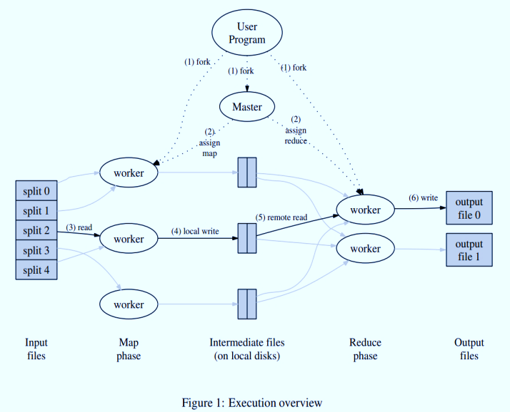
Implementing MapReduce
Implementation varies - based on environment being used upon
Example implementation:
Dual-processor x86 machines running Linux, with 2-4GB of memory per machine
Commodity networking hardware
Cluster has hundreds or thousands of machines
Machine failures expected
Storage using IDE disks on each machine and a distributed file system to manage data
Submitted jobs pass through a scheduling system
Each job’s set of tasks is assigned to available machines within the cluster
7 Step Execution
The MapReduce library splits the input files and starts copies of the program on a cluster of machines
One copy becomes the master and it assigns work to the remaining
A worker reads the input, parses key/value pairs to pass into the Map function and are buffered in memory
The buffered pairs are written to local disk, partitioned into R regions and forwarded to the reduce workers
Reduce workers read the buffered data from the local disks, sorts the data by key to get all occurrences of the same key together to do same reduce tasks
Reduce worker passes the key and corresponding values to the Reduce function and the output gets stored in a final output file for this reduce partition
Once all map and reduce tasks are done, control is given back to the user code
Notes:
Extremely ugly slide...sorry…

Slide 4
Analysis
MapReduce appears to be an easy tool to use when looking to distribute work over a cluster of machines
Since it automatically takes care of coordination between machines in the cluster, that would improve productivity of the programmer
More time to add to the tasks versus taking up time coordinating
Graceful fault-tolerance in MapReduce is a motivating feature, as the program won’t crash if one machine fails
As this takes time, it would be wasteful to have to restart the entire program if one machine were to break down
Use of local storage on machines after Map seems helpful, but if a machine only finished Map when it fails, then Map must be done again
Seems redundant and counterproductive if/when many machines fail
Redundant execution is used towards the end to ensure completion time isn’t halted by a slow machine
Seems like a good idea, but a lot of overhead is being added into the program when in most cases, it might not need to
Google uses it – so it must be good.
Notes:
Resisted urge to put “automagically” on slideshow – didn’t resist urge to write it here though!

Slide 5
MapReduce vs Comparison Paper
Comparison paper supports claim of MapReduce’s simple model to utilize a cluster of machines
Mentions specifically as a learning tool
Parallel DBMS also provide a high-level programming environment
Parallel DBMS need a well-defined schema for data, instead of a schema, MR needs a custom parser to gather data
Unlike Parallel DBMS’ use of hash or B-tree indexes, MR does not provide indexing, which is complicated to implement and maintain
DMBS use straight forward requests for information versus MR needing to provide an algorithm to request data
Basic database tasks take significantly longer to load and execute for MR then it does for Parallel DBMS
MR performs complete table scans, while DBMS takes advantage of clustered indexes – MR deals with more overhead
MR has a slow-to-begin “cold start” versus the quick-and-ready “warm start” that DBMS has
Both are easy to use, but MR is difficult to maintain once beyond beginner concepts

Slide 6
Advantages/Disadvantages
Advantages
With independence of each machine in the cluster and no schema required, MapReduce is very flexible
Creation of high-level languages Pig and Hive to alleviate implementation of repetitive tasks done with MapReduce
Best implementation of fault tolerance
Less challenging to install and configure properly MapReduce(Hadoop)
Minimizes work lost when a machine in the cluster fails
Disadvantages
With each machine being independent in the cluster, and not having a defined schema, MapReduce could easily be corrupt by bad data
Forced to write algorithms in a low-level language in order to perform record-level manipulation in MapReduce
Reduce creates multiple output files, so another instance of Reduce would be necessary to combine them all into one file
Load and execution time of basic tasks take significantly longer time for MapReduce(Hadoop) versus DBMS (Vertica & DBMS-X)
Extensive amount of overhead

